Slide 1

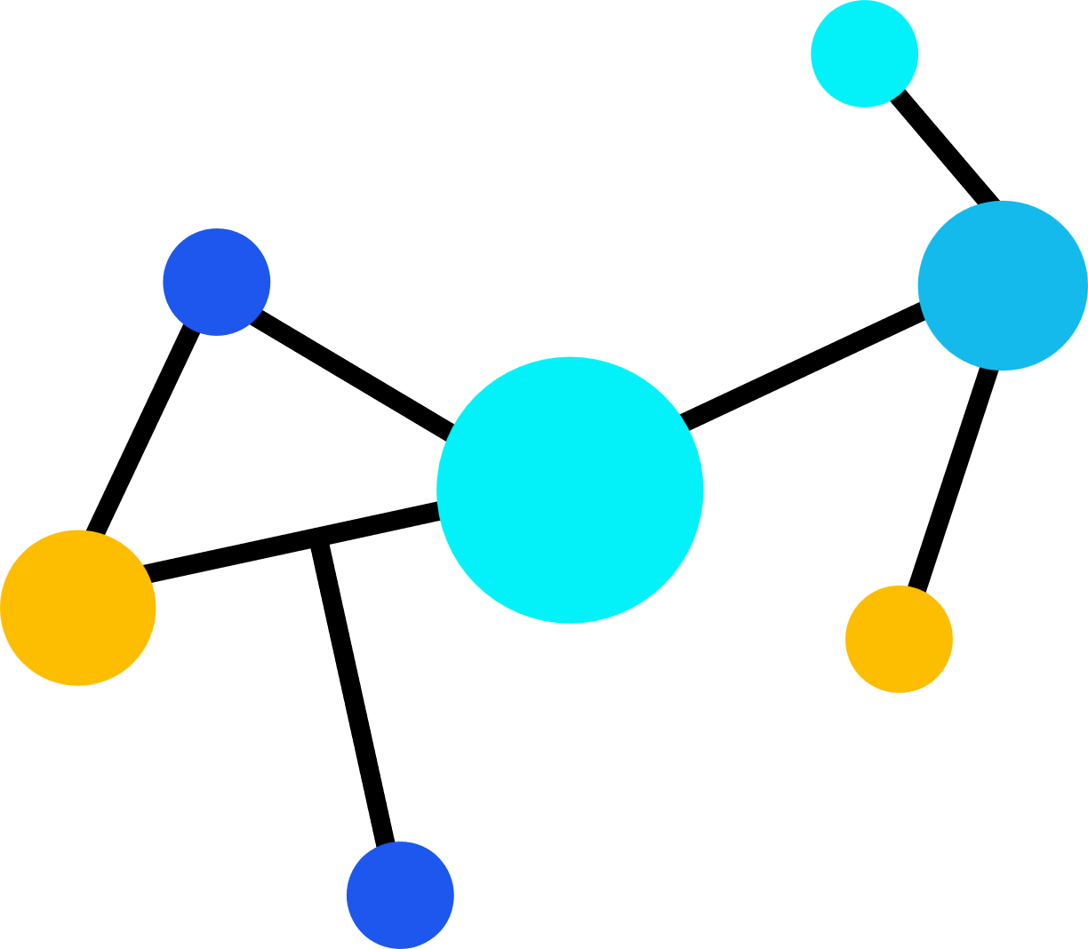


CMP301 | COMPUTER NETWORKING | COURSEWORK 2
SSL/TLS Technology and
Traffic Analysis Using Wireshark
Group Presentation — Group Members & Student IDs
Presented By:

Slide 2
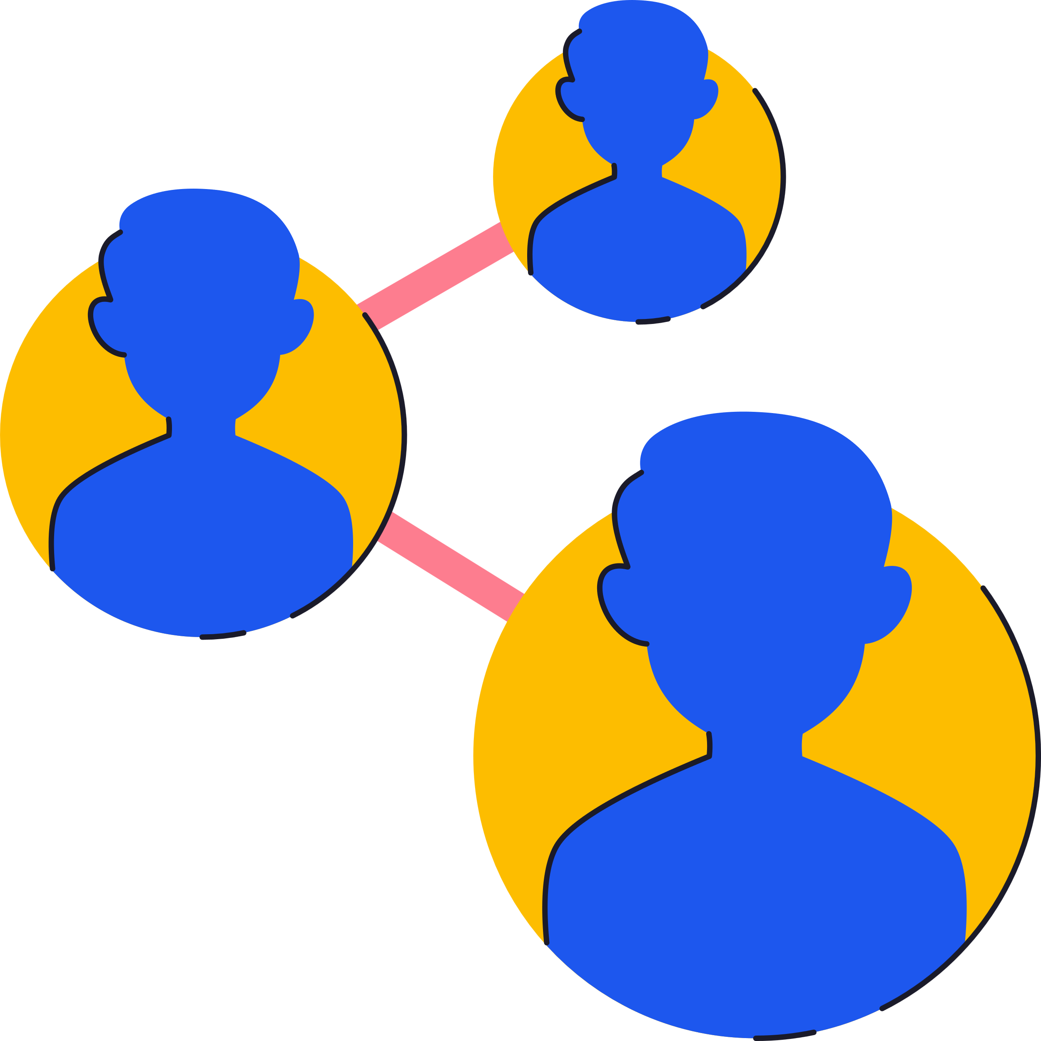


Presentation Agenda
Our Mission
1. Introduction to SSL/TLS
5. The TLS Handshake
2. HTTP vs HTTPS
6. Wireshark Traffic Analysis
3. Encryption Fundamentals
7. Benefits, Challenges & Applications
4. PKI & Digital Certificates
8. Conclusion & References

Slide 3

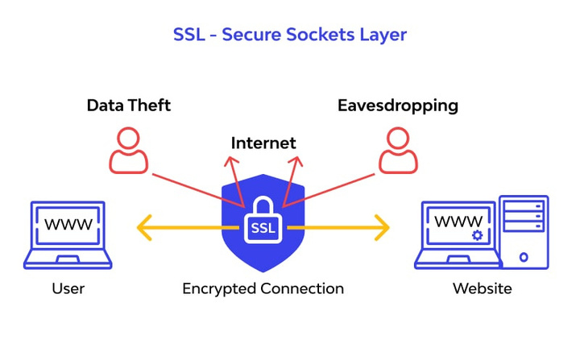


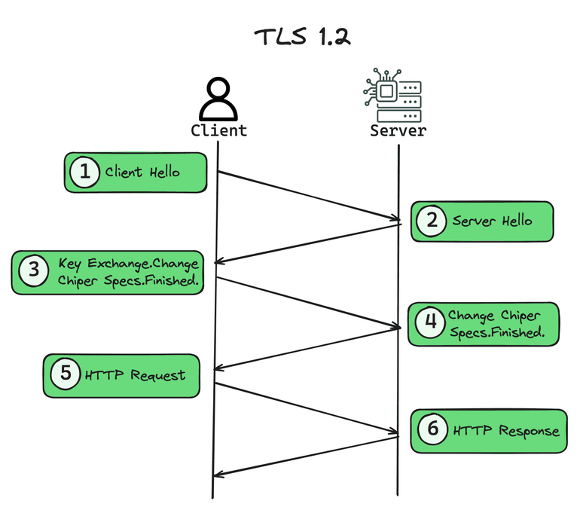




PART 1 · INTRODUCTION
Introduction to SSL/TLS
What is SSL?
Secure Sockets Layer—the original protocol (Netscape, 1995) for encrypting data sent between a client and a server over the internet.
What is TLS?
Transport Layer Security — the modern, standardized successor to SSL, defined by the IETF, offering stronger cryptography.
Why TLS replaced SSL
SSL had known design flaws (e.g. POODLE) and weak cipher support; TLS fixed these and is actively maintained.
Why secure communication matters
Protects confidentiality, integrity, and authenticity of data such as passwords, banking details, and personal information in transit.

Slide 4

PART 1 · INTRODUCTION
History of SSL & TLS
Redesigned; later broken by the POODLE attack (2014)
Added protection against CBC attacks,
Introduced explicit Initialization Vectors (IVs)
2008
TSL 1.2
RFC 8446: faster handshake, removes legacy ciphers
1995
SSL 2.0
1999
TSL 1.0
First public release; multiple security weaknesses
1996
SSL 3.0
IETF standard (RFC 2246); SSL 3.0 upgrade
2006
TSL 1.1
Widely deployed; supports SHA-256, AEAD ciphers
2018
TSL 1.3
Industry adoption: TLS 1.2 remains widely supported; TLS 1.3 is now the recommended standard across major browsers, CDNs and servers, with SSL 2.0/3.0 and TLS 1.0/1.1 formally deprecated.

Slide 5



PART 1 · INTRODUCTION
HTTP vs HTTPS
HTTP
HTTPS
Hyper Text Transfer Protocol
Uses Port 80
Data sent in plaintext — readable if intercepted
No padlock icon shown in the browser
Flagged as “Not Secure” by modern browsers
HTTP Secure — HTTP layered over SSL/TLS
Uses Port 443
Data is encrypted in transit
Padlock icon shown next to the address bar
Favoured by Google—boosts SEO ranking

Slide 6









PART 2 · SSL/TLS CONCEPTS
Encryption Concepts
Plaintext
Encryption
Ciphertext
Decryption
The original, readable data before any encryption is applied—e.g., a login form submission.
The process of transforming plaintext into unreadable ciphertext using an algorithm and a key.
The scrambled, unreadable output of encryption — meaningless without the correct decryption key.
The reverse process: converting ciphertext back into plaintext using the correct key.
Flow: Plaintext → Encryption → Ciphertext → Decryption → Plaintext

Slide 7



PART 2 · SSL/TLS CONCEPTS
Public Key & Private Key Encryption
Symmetric Encryption
Asymmetric Encryption
One shared secret key encrypts and decrypts data
Fast — used for bulk data once the connection is secure
Challenge: securely sharing the key in the first place
Uses a mathematically linked key pair
Public Key: shared openly, used to encrypt
Private Key: kept secret, used to decrypt
Session Key: TLS uses asymmetric encryption only during the handshake to safely agree on a temporary symmetric session key, which then encrypts the actual application data combining security with speed.

Slide 8






PART 2 · SSL/TLS CONCEPTS
PKI & SSL Certificates
Certificate Authority (CA)
Root CA
A trusted third party (e.g., DigiCert, Let’s Encrypt) that verifies identity and issues digital certificates.
Digital Certificate
An electronic document binding a public key to an identity (domain/organization), signed by a CA.
Intermediate CA
Public Key Infrastructure (PKI)
The full framework of roles, policies, and systems used to create, manage, and revoke certificates.
Trust Chain
Root CA → Intermediate CA → Server certificate; browsers trust the chain if it leads to a known root.
Server Certificate

Slide 9





PART 2 · SSL/TLS CONCEPTS
Authentication & Hashing
Authentication
Digital Signature
Confirms that the server (and optionally the client) is who it claims to be, using its certificate and private key.
Data encrypted with a private key that anyone can verify with the matching public key, proving origin and integrity.
Hashing
Message Authentication Code (MAC)
A one-way function (e.g. SHA-256) that converts data into a fixed-length digest to detect any tampering.
A hash combined with a secret key, used to verify both the integrity and authenticity of transmitted data.

Slide 10





PART 3 · TLS HANDSHAKE
How SSL/TLS Works
1. Requests a secure connection (ClientHello)
2. Responds with certificate & chosen cipher
Browser (Client)
Web Server
3. Secure, encrypted communication begins
The browser requests a secure connection and lists the cipher suites it supports.
The server responds with its digital certificate and selects a cipher suite; both sides derive a shared session key.
Once the handshake completes, all further application data is encrypted using that session key.

Slide 11

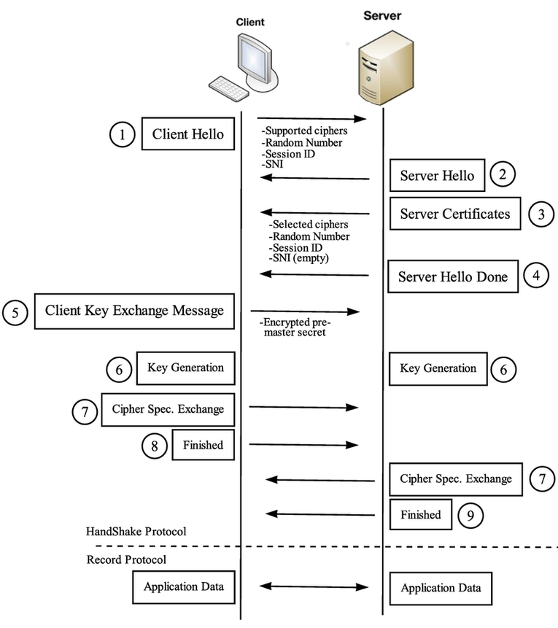
PART 3 · TLS HANDSHAKE
TLS Handshake Timeline

Slide 12
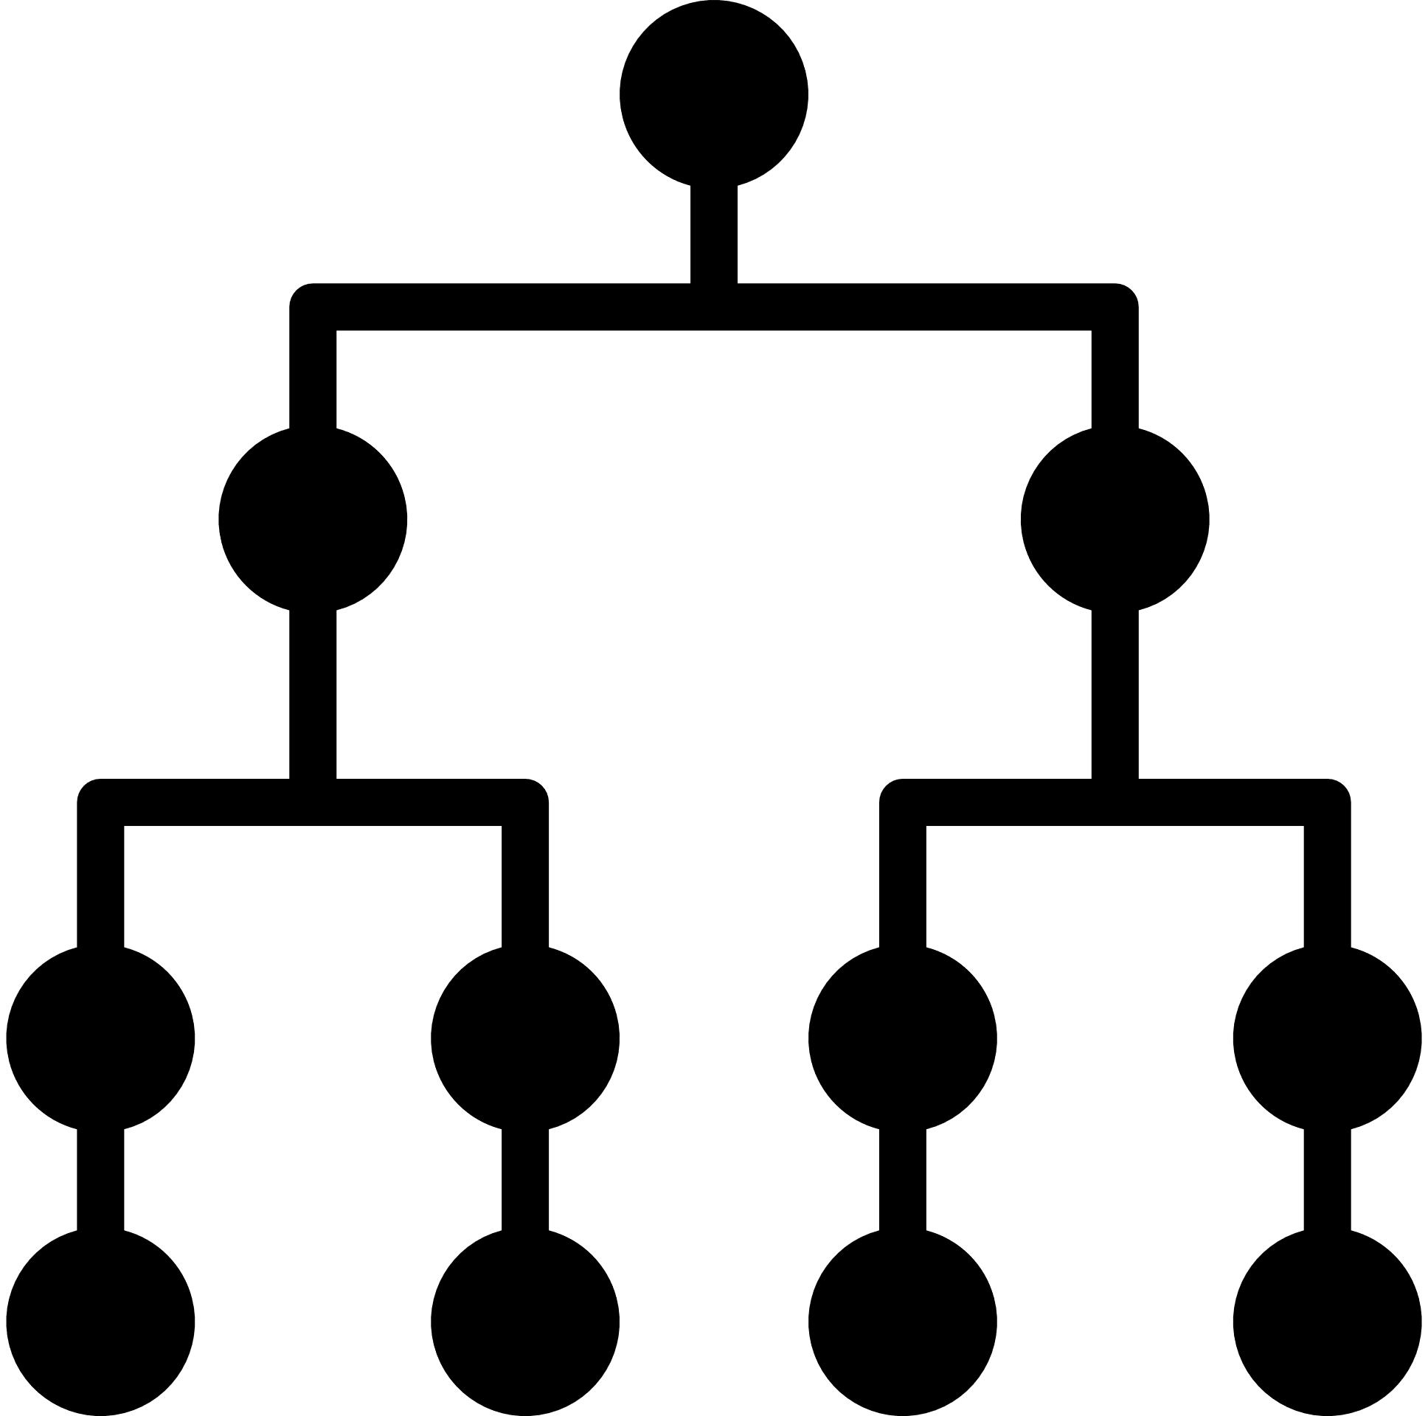








PART 3 · TLS HANDSHAKE
The TLS Record Protocol
Application Data
TLS Record Protocol
The layer beneath the handshake that actually carries and protects all TLS traffic—handshake, alert and application data.
Fragmentation
Encapsulation
Each message is fragmented, optionally compressed, then wrapped with a header, MAC, and encryption before being sent.
Compression (optional)
Record Layer
Adds a 5-byte header (type, version, length) to every record so the receiver can correctly reassemble and decrypt it.
Add MAC
Data Protection
Provides confidentiality (encryption) and integrity (MAC) for every record exchanged after the handshake completes.
Encrypt
Record Header + Ciphertext

Slide 13
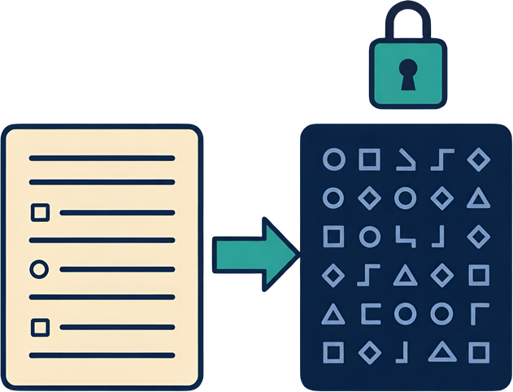
PART 3 · TLS HANDSHAKE
Cipher Suites
A cipher suite is the combination of algorithms a client and server agree to use for a TLS session.
It defines the key exchange method, the bulk encryption algorithm, and the authentication / hashing scheme.
The server selects one suite from the client's offered list during the handshake.
TLS_ECDHE_RSA_WITH_AES_128_GCM_SHA256
TLS
ECDHE
RSA
AES_128_GCM
SHA256
Protocol
Key Exchange
Authentication
Bulk Encryption
Hash / MAC
Indicates the protocol in use (TLS).
Elliptic Curve Diffie-Hellman Ephemeral — provides forward secrecy.
The server authenticates itself using an RSA certificate/signature.
AES with a 128-bit key in Galois/Counter Mode — encrypts the data.
SHA-256 is used for the handshake integrity check (HMAC/PRF).

Slide 14



PART 4 · WIRESHARK ANALYSIS
Introduction to Wireshark
What is Wireshark?
A free, open-source network protocol analyser used to capture and inspect traffic in real time.
Packet Capture
Wireshark listens on a network interface and records every packet, including its full header and payload.
Packet Analysis
Captured packets are decoded layer-by-layer against the OSI model, from Ethernet up to the Application layer.
TLS Filter
The display filter tls (or ssl) isolates only TLS handshake and application-data records for focused analysis.

Slide 15
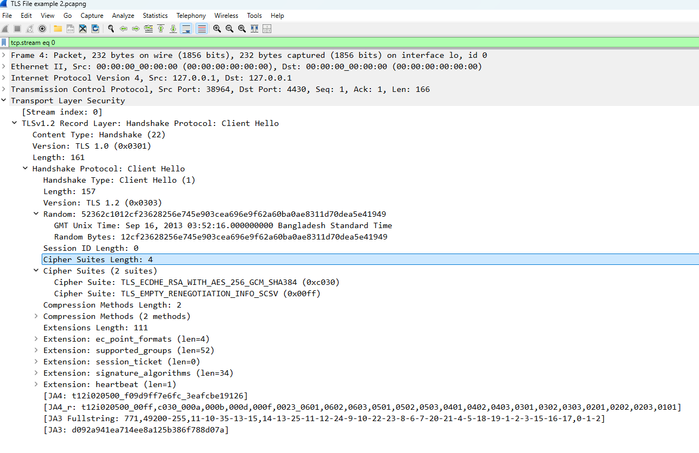
PART 4 · WIRESHARK ANALYSIS
Client Hello Analysis
TLS Version: highest protocol version the client supports.
Random: 32-byte client-generated value used in later key derivation.
Cipher Suites: the ordered list of encryption combinations the client offers.
Extensions: e.g., SNI (requested hostname), supported groups, ALPN.

Slide 16
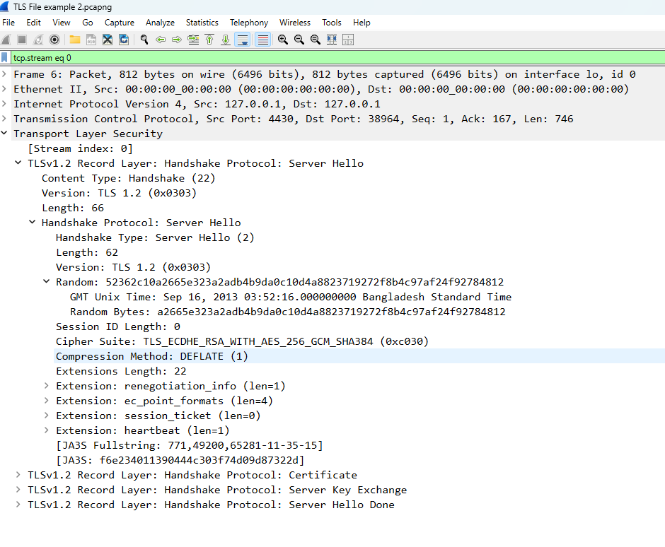
PART 4 · WIRESHARK ANALYSIS
Server Hello Analysis
Selected TLS Version: the protocol version the server has chosen to use.
Selected Cipher Suite: the single suite chosen from the client's offered list.
Session ID: identifier that may allow the session to be resumed later.
Server Random: combined with the client random to derive session keys.

Slide 17
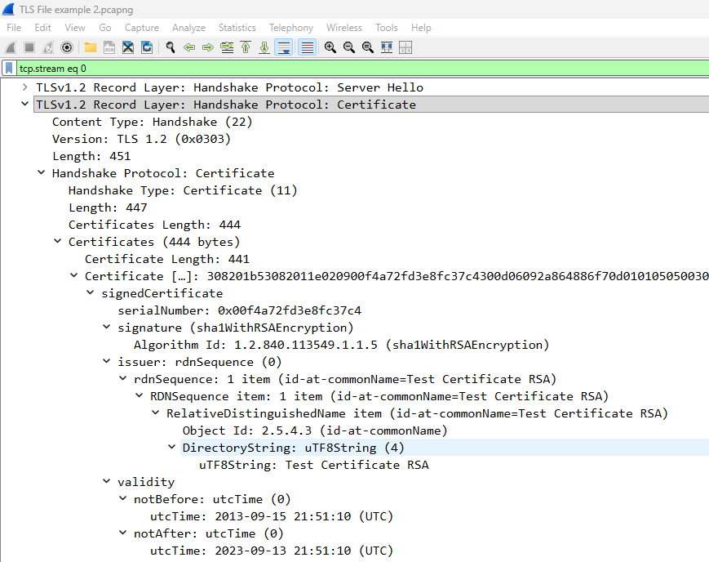
PART 4 · WIRESHARK ANALYSIS
Certificate Analysis
Issuer: the Certificate Authority that signed the certificate.
Validity: the certificate's not-before / not-after date range.

Slide 18
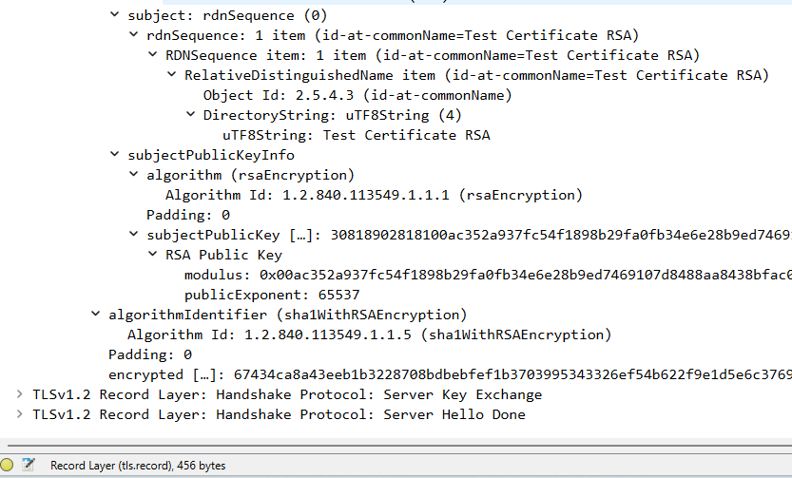
PART 4 · WIRESHARK ANALYSIS
Certificate Analysis
Subject: the entity (domain/organization) the certificate was issued to.
Public Key: the key bound to this certificate, used for authentication.
Signature Algorithm: e.g., SHA256withRSA, used to sign the certificate.

Slide 19
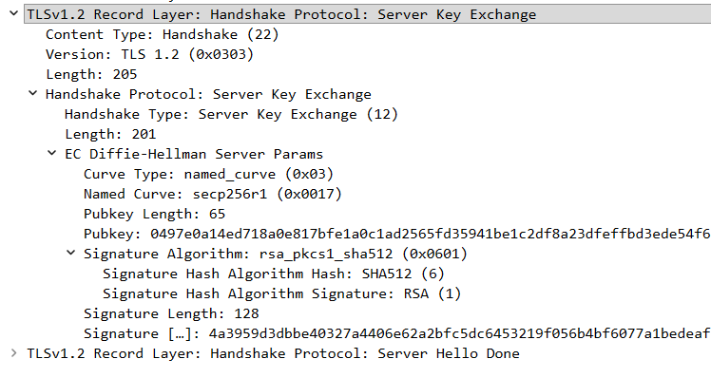
PART 5 · WIRESHARK ANALYSIS (CONT.)
Server & Client Key Exchange
Key Exchange: the mechanism (e.g., ECDHE) used to agree on secret material without sending it in plaintext.
Shared Secret: a value both sides compute independently that never travels across the network.

Slide 20
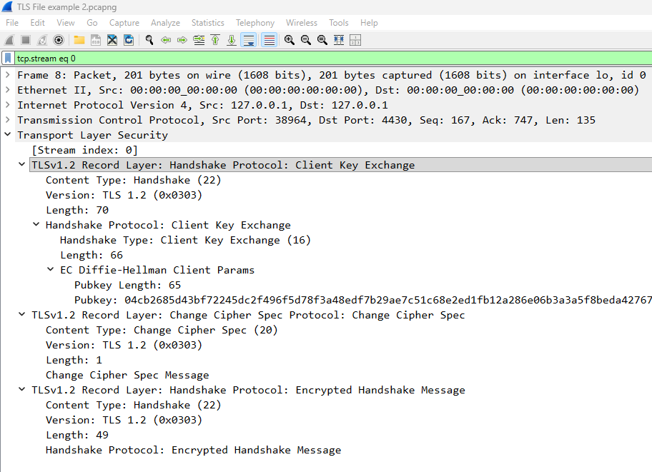
PART 5 · WIRESHARK ANALYSIS (CONT.)
Server & Client Key Exchange
Session Key: derived from the shared secret and both random values; used to encrypt all further traffic.

Slide 21
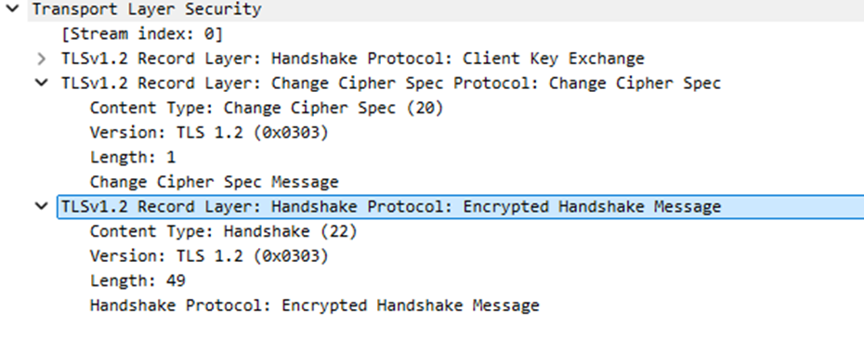
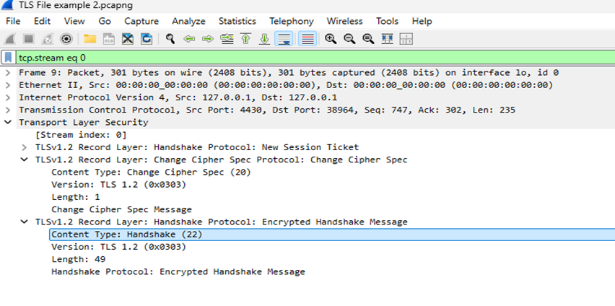
PART 5 · WIRESHARK ANALYSIS (CONT.)
Change Cipher Spec & Finished
Change Cipher Spec signals that all subsequent records will be encrypted using the newly agreed session key.
Encryption begins: from this point, both sides switch from plaintext handshake messages to encrypted records.
Finished: the first encrypted message, verifying the handshake was not tampered with—handshake complete.

Slide 22
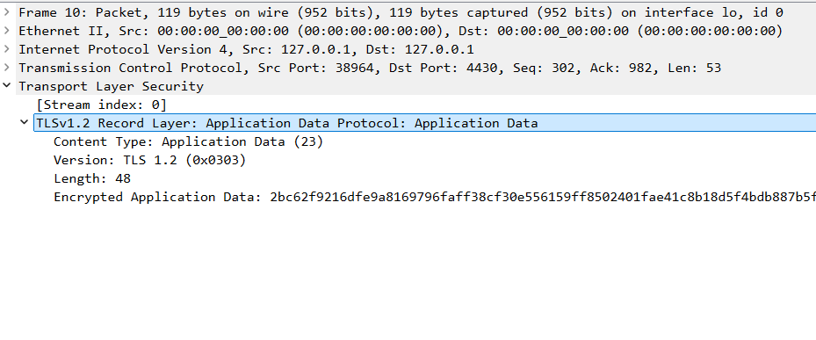
PART 5 · WIRESHARK ANALYSIS (CONT.)
Application Data
Encrypted Traffic: Wireshark shows only opaque ciphertext — the actual content cannot be read without the session key.
Secure Communication: This confirms the connection is fully protected for the remainder of the session.
Note: packet lengths and timing are still visible, which is why traffic analysis is still possible even on encrypted flows.

Slide 23
WRAP-UP
Benefits, Challenges & Real-World Applications
Benefits
Challenges
Applications
Confidentiality
Integrity
Authentication
Certificate expiry
Weak / outdated ciphers
Misconfiguration issues
Valid certificate ≠ trustworthy site — phishing pages can hold real certs
Deployment risk: non-HTTPS or weak-TLS sites get browser warnings & can be penalised in Google search rankings
Online banking
E-commerce
Email
VPNs

Slide 24
WRAP-UP
Conclusion & References
Conclusion
References
SSL/TLS secures internet communication through encryption, authentication and integrity checks.
The handshake establishes trust and a shared session key before any application data is sent.
Wireshark analysis confirms the handshake steps and shows that data is unreadable once encrypted.
TLS is essential to protecting users on the modern web — from banking to everyday browsing.
Rescorla, E. (2018) RFC 8446: The TLS Protocol Version 1.3. IETF.
Dierks, T. & Rescorla, E. (2008) RFC 5246: The TLS Protocol Version 1.2. IETF.
Wireshark Foundation (2024) Wireshark User’s Guide. wireshark.org.
Cloudflare (2023) What Happens in a TLS Handshake? Cloudflare Learning Center.
DigiCert (2023) What Is a Digital Certificate & How Does It Work? DigiCert Inc.
Mozilla (2023) Public Key Infrastructure (PKI). MDN Web Docs.
Google Search Central (2023) HTTPS as a Ranking Signal. Google LLC.

Slide 25
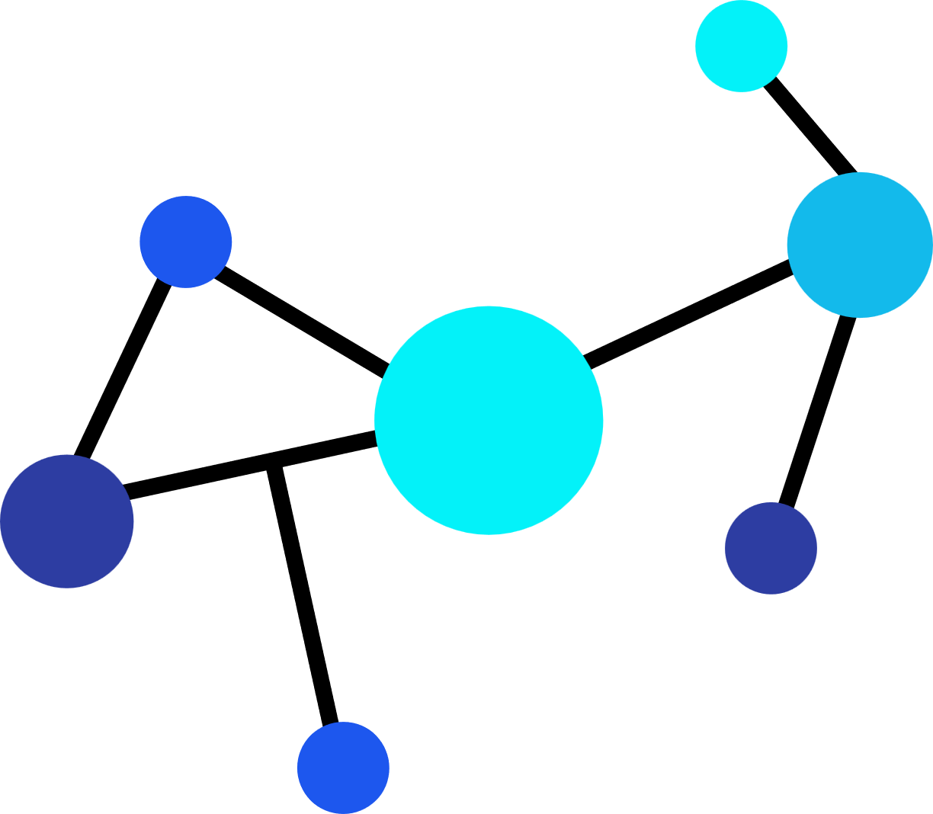
CMP301 Computer Networking
Thank you so much

